Slide 1
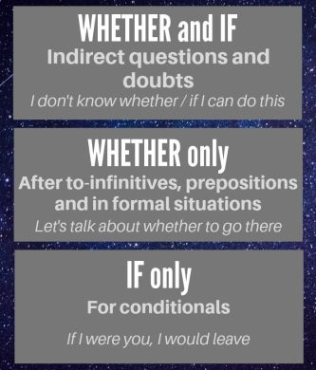

Slide 2
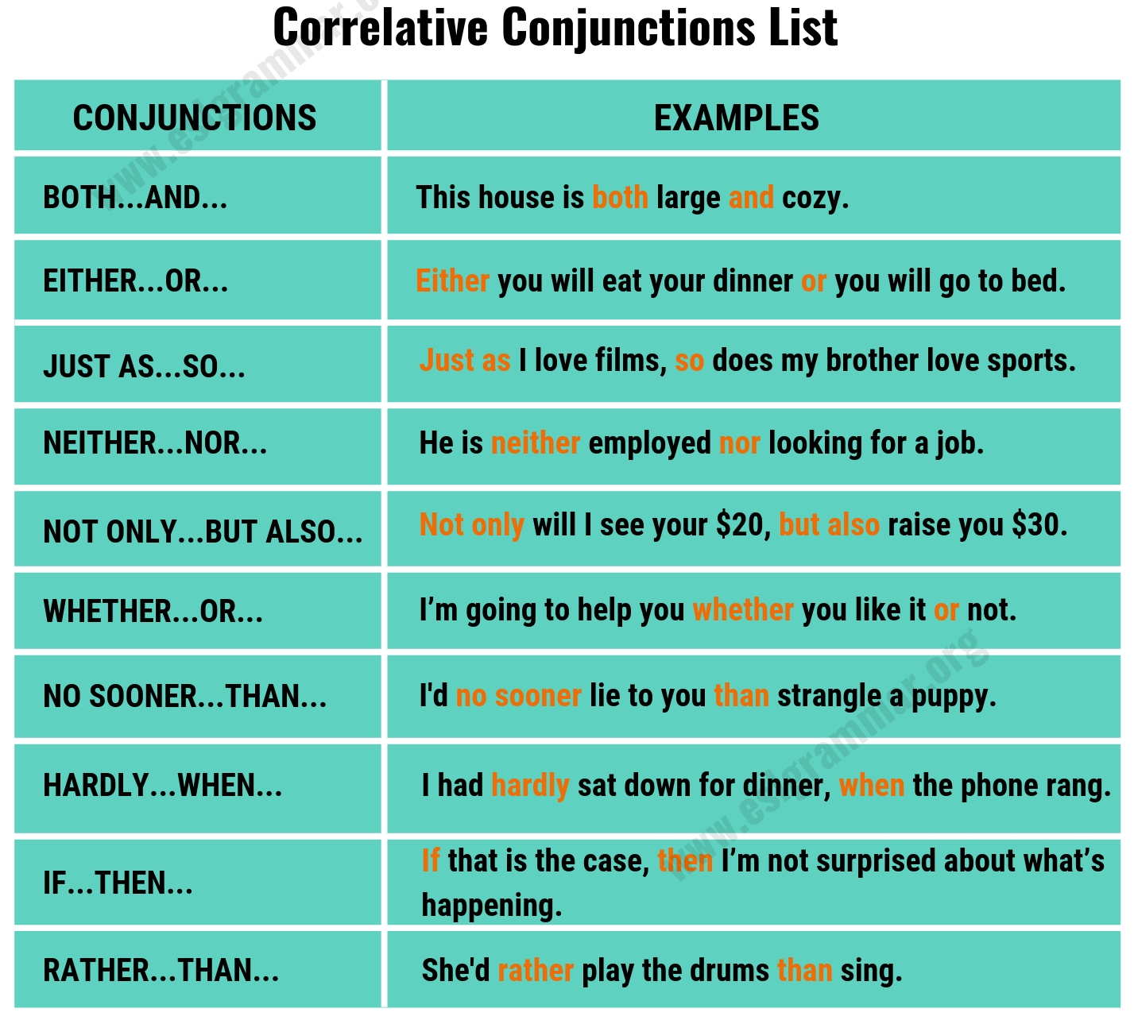

Slide 3
Complete each sentence using the correct correlative conjunction.
___ I go swimming, ___ I will go hiking.
2. She ___ likes cats ___ dogs.
3. My brother ___ remembers his past well ___ cannot recall yesterday's events.
4. He _ only likes outdoor sports ___ cannot stand indoor games.
5. ___ we secure a place in the college, ___ we will have to look for alternatives.
6. ___ the teacher ___ the students were prepared for the principal’s visit.
7. I can’t decide ___ to buy the TV ___ wait until the new model comes out.

